Slide 1
Industrial Chemicals Can Be Eco-Friendly! Myth or Fact?
MYTH RESULTS
From
Laurie Lehmberg
Texas Instruments

Slide 2
Agenda
Introduction
Overview of Texas Instruments
Myth Buster: Can Industrial Chemicals be Eco-Friendly?
What are Industrial Chemicals
Use of Industrial Chemicals
Reuse of Industrial Chemicals
Myth of Fact?

Slide 3
Unlock the possibilities

Slide 4
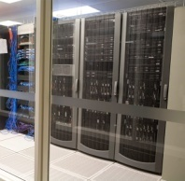
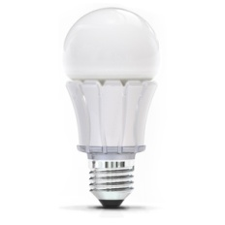
We keep the world turning with innovations that make life safer, smarter, healthier, greener and more fun.

Slide 5
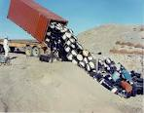
Industrial Chemicals have a Legacy
Quote from an environmentally friendly Maine Legislator
“In the ‘70s, what people thought of when they heard the word IPA was a drum in a sandpit. Now we think of IPA as a valuable product”
The sins of the ’60s,
Discovered in the ‘70s,
Regulated in the ‘80s,
Enforced in the 90’s
’70s
Today

Slide 6
What are Industrial Chemicals?
Industrial chemicals are not defined merely by where they are used
Ammonia, Sodium Hypochlorite, Sodium Hydroxide, Sulfuric Acid, Nitric Acid, Hydrogen Peroxide, Ethanol, Isopropyl Alcohol, Hydrocarbons…
Chemicals are generated from highest to lowest purity (ACS Grade to Technical Grade)
Industrial applications for the chemicals have specific requirements that may allow impurities

Slide 7
Use of Industrial Chemicals Semiconductor Fabrication
Multiple-step sequence of photolithographic and chemical processing during which electronic circuits are gradually created on a wafer made of pure semiconducting material (usually silicon).
Performed in specialized facilities referred to as fabs which are pressurized with filtered air to remove even the smallest particles.

Slide 8
Use of Industrial Chemicals
Semiconductor Fabrication examples
Stripping – High purity level
Sulfuric Acid and N-methyl pyrrolidone (NMP)
Aqueous cleaning – High purity level
Sulfuric Acid
Isopropyl Alcohol (drying wafers after wet processing)
pH neutralization for environmental abatement equipment. Low purity level
Sulfuric acid
Sodium Hydroxide
Ultra Pure Water resin bed regeneration. Medium purity level
Sulfuric acid
Sodium Hydroxide

Slide 9
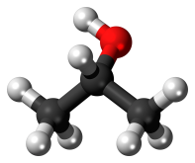
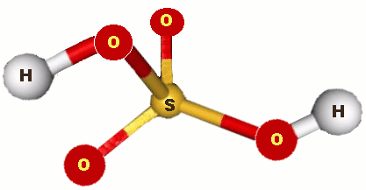
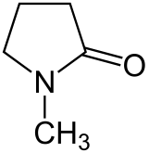
Secondary Uses of Industrial Chemicals
Effective substitute for a commercial product
IPA: cleaning solutions, fuel additives, printing inks, laboratory preservative, etc.
Sulfuric acid: fertilizers, detergents, drain cleaner, antifreeze, pickling (cleaning) iron and steel before plating, water treatment, paints, enamels, printing inks, batteries, etc.
N-methyl pyrrolidone (NMP): surface treatment of textiles, resins and metal coated plastics, paint stripper, etc.

Slide 10
Eco-Friendly Use of Industrial Chemicals
Build synergies
TCEQ Resource Exchange Network for Eliminating Waste (RENEW)
materials-exchange network to promote the reuse or recycling of surplus materials, by-products, and wastes
Chemical manufacturers or associations
E2 Tech
http://www.chemicalrecyclingsolutions.com/
Maine has strict hazardous waste handling requirements. Care must be taken to comply with these requirements.

Slide 11
Q&A

